Slide 1



Recalibrating Strong-Line Metallicity Diagnostics: Chemical Abundances from Composite Galaxy Spectra
Reagen Leimbach
Faculty Advisor: Dr. Chun Ly; Steward Observatory
Space Grant Research Symposium
April 13th, 2019
Notes:
Hello, my name is Reagen Leimbach and over the past two years, I have been working with Dr. Chun Ly on my project to Recalibrate the Strong-Line Metallicity Diagnostics for high redshift galaxies.

Slide 2
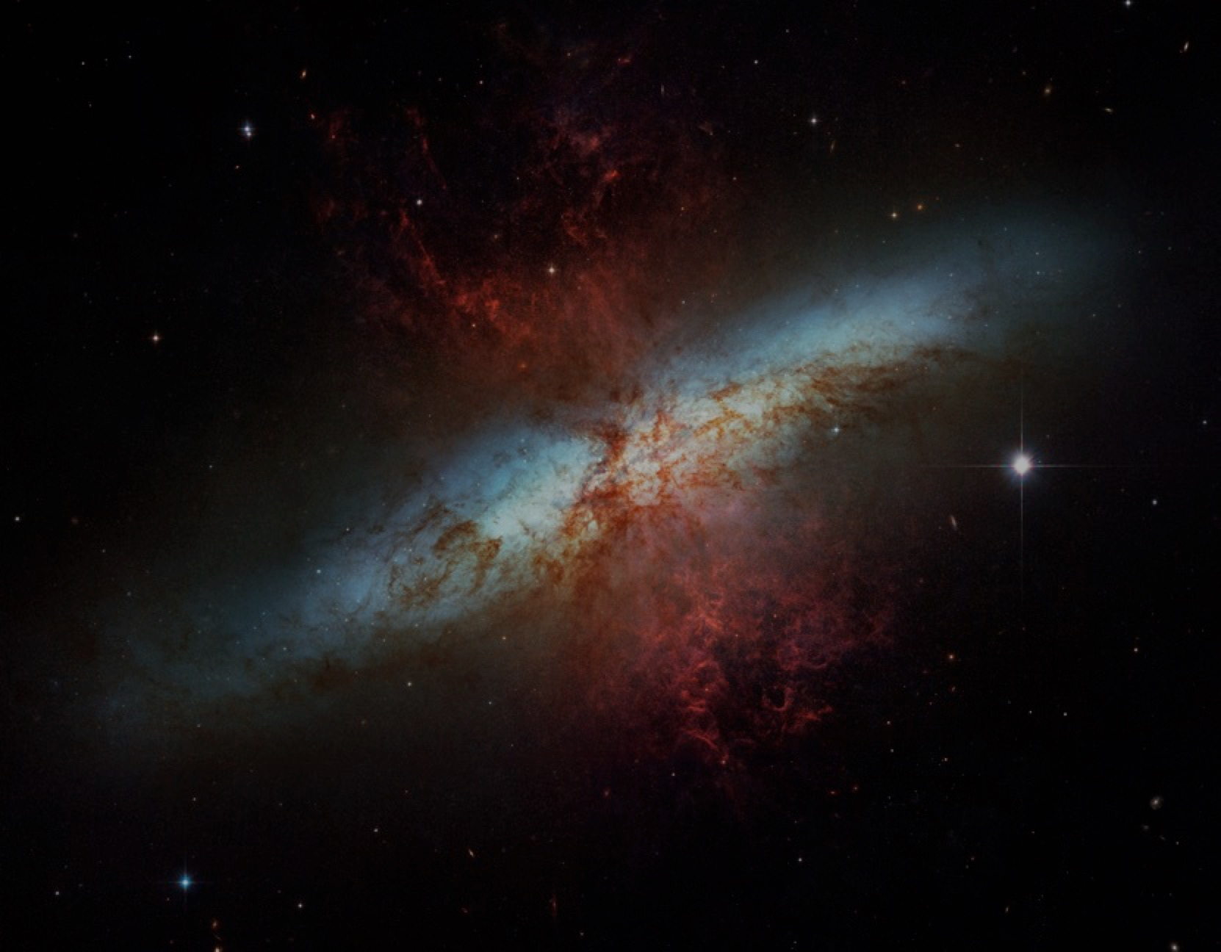
Background
Galaxy evolution is driven by physical processes such as gas accretion, star formation, and gas outflows from supernovae, which directly affect the interstellar gas in galaxies.
One way to test theoretical modeling of these processes is by measuring the correlation of heavy metal gas abundances (“metallicity”) against stellar mass (M).
Notes:
M82 Starburst Galaxy that is believed to look like the galaxies in this study.
Galaxy evolution is driven by physical processes such as gas accretions, star formation, and gas outflow. By knowing the gas metallicity to stellar mass correlation, we can test our theoretical models of these processes.

Slide 3
Background
In past studies, local metallicity diagnostics were used to study high redshift galaxy evolution.
Here, they implicitly assume that these galaxies resemble local ones.
However, as we learned from studying high-redshift galaxies, we see significant differences in galaxy properties.
These differences are problematic and cause the greatest amount of uncertainty in galaxy evolution studies.
Notes:
Previous calibrations of the gas are invalid for distant galaxies because the properties of gas behave differently at high redshift. These differences are the greatest source of uncertainty when studying galaxy evolution.
As we look farther away, the differences in properties breaks local metallicity calibrations.
High redshift galaxies are early universe galaxies
As you go towards higher redshift the galaxies star formation can increase by a lot (10%)

Slide 4
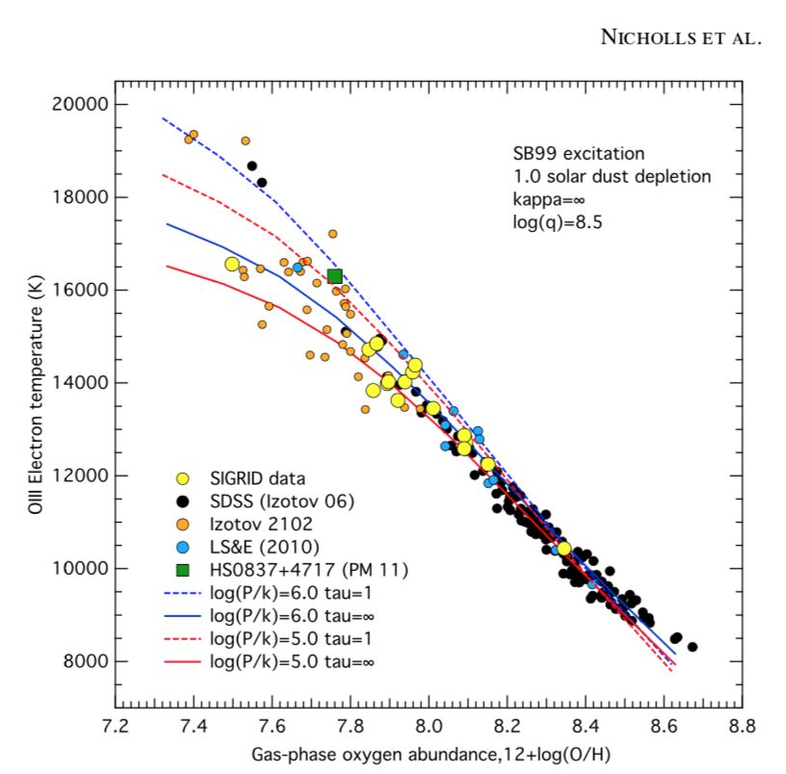
Objectives
Nicholls et al. 2014
We are re-developing the strong-line calibration by stacking spectra to detect [O III]λ4363. It is a weak excitation line whose flux is directly related to the electron temperature.
Electron Temperature (K)
Gas-phase oxygen abundance
The advantage of this approach is that the electron temperature is directly correlated with the gas-phase metallicity.
Notes:
Equilvalence to 100 10m telescopes (KECK) 33yds
Very little dispersion
In an attempt to fix this uncertainty, we are redeveloping the strong-line calibration by detecting the oxygen III 4363 emission line in distant galaxies. This is a very weak emission line, so stacking spectra with similar strong-line diagnostics allows for better detections. The flux of this emission line is directly related to the electron temperature. The electron temperature is correlated with the gas-phase metallicity as seen in Nicholls et al 2014 paper.
Heavier elements cool by radiation and the more elements you have the faster it cools
Electron temperature refers to kinetic energy

Slide 5
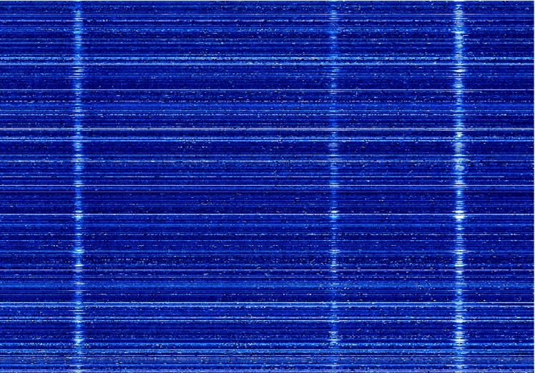
Objectives
Because [O III] λ4363 is very weak, a large telescope aperture (e.g. 10m Keck) and large sample size are needed
DEEP2 is the largest spectroscopic study at z ~1 for low-mass galaxies
λ= 4861 λ= 4958 λ= 5007
Horizontal lines: represent individual spectra
Three vertical lines: emission lines utilized in this study
Notes:
Because the emission line is weak, we need a large telescope aperture and a large sample size. The DEEP2 data set is the largest spectroscopic study of low-mass galaxies.
To increase the signal-to-noise (S/N) ratio, we first begin by restricting the DEEP2 data set to galaxies with reliable measurements (S/N > 3) of the strong emission lines, [OII]λ3727, Hβ, and [OIII]λ5007. With this restriction, we have 2813 galaxy spectra and now we are finding that addition restrictions will be needed to eliminate AGNs.
The image of the right show hundreds of spectra after we have limited our sample size and shifted them back to the rest frame. Each horizontal line is an individual spectra. The three vertical lines are the hydrogen beta transition and two oxygen emission lines (4958, 5007).

Slide 6
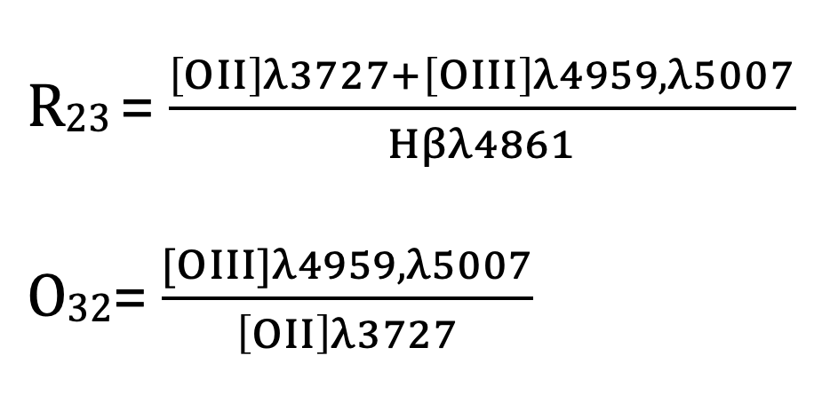
We bin the galaxies based on two strong-line flux ratios, R₂₃ and O₃₂.
Notes:
We are binning based on two strong line ratios, R23 and O32. These are calculated for each spectra based. R23 is the flux….. O32 is the flux….
R23 and O32 are the most common strong line diagnostics used in studying galaxy evolution.

Slide 7
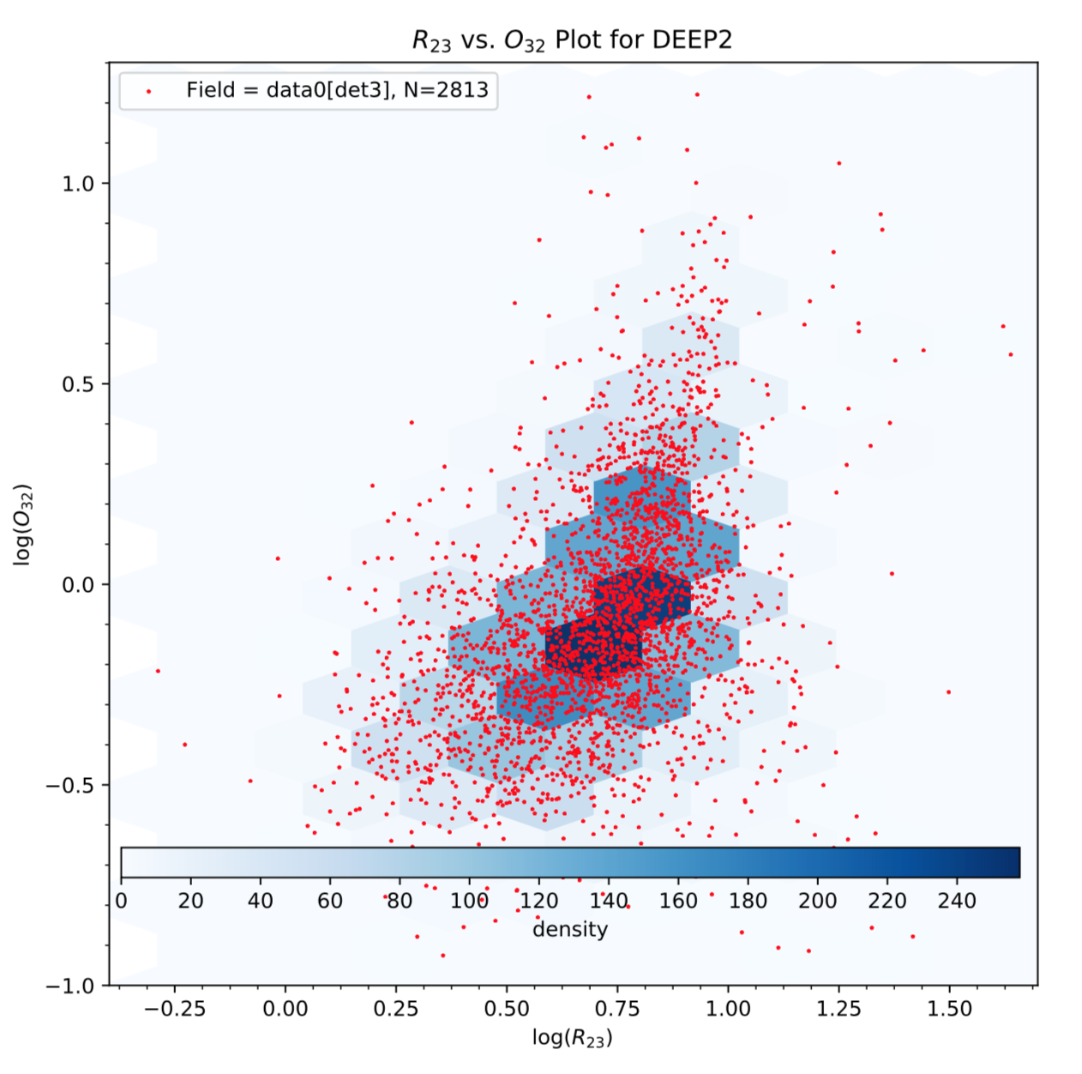
First Binning Method… a uniform grid to sort galaxies
Log(O₃₂)
Density
Log(R₂₃)
Notes:
The first binning method I attempted utilized a uniform grid in R23 and O32. Each bin covers a set region of R23 and O32.
Each hexagon represents a bin and each red dot represents a spectra. The dark blue bins have more spectra in them than the lighter shaded ones.
This method did not allow the bins to adapt based on the density of galaxies in the region. The range of the number of galaxies in each bin did not give many detections.

Slide 8
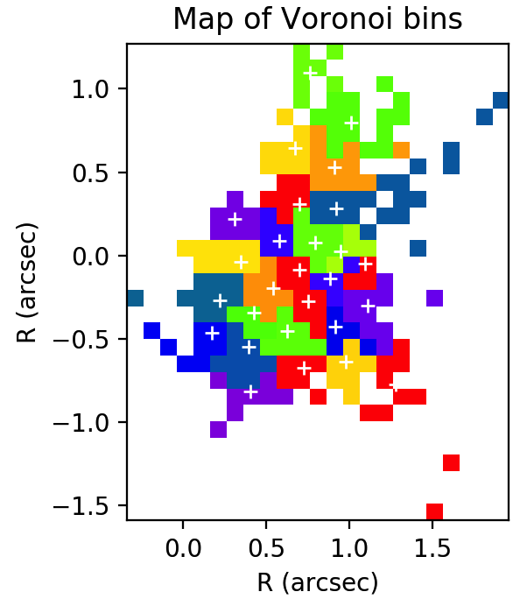
Second Binning Method...
uses the Centroidal Voronoi Tessellation algorithm (Cappellari & Coppin 2003)
Log(O₃₂)
This two-dimensional data binning technique sorts the data adaptively based on the distribution of galaxies in the R₂₃—O₃₂ plane.
Log(R₂₃)
Notes:
The second binning method utilized an adaptive grid developed by Cappellari and Coppin (2003). It starts in the area of highest density of spectra and calculates a bin size.
Starts in the highest density area and moves towards lower densities
Not good because the range of R23 and O32 values varies too much. We don’t have enough control over bins to draw any conclusions

Slide 9
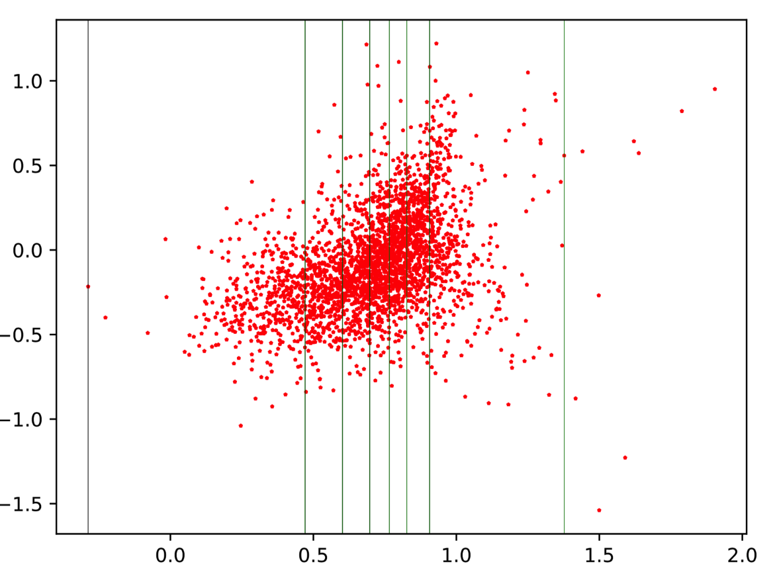
Current Binning Method…
Log(O₃₂)
Log(R₂₃)
Notes:
The current binning method I am using is a combination of the last two.
First, we sort and bin the data based on its R23 values.
Then divide those bins by the O32 value based on number of galaxies in each R23 bin.

Slide 10
Current Binning Method…
O₃₂ division happens at different values
Log(O₃₂)
Log(R₂₃)
Notes:
The current binning method I am using is a combination of the last two.
First, we sort and bin the data based on its R23 values.
Then divide those bins by the O32 value based on number of galaxies in each R23 bin.

Slide 11
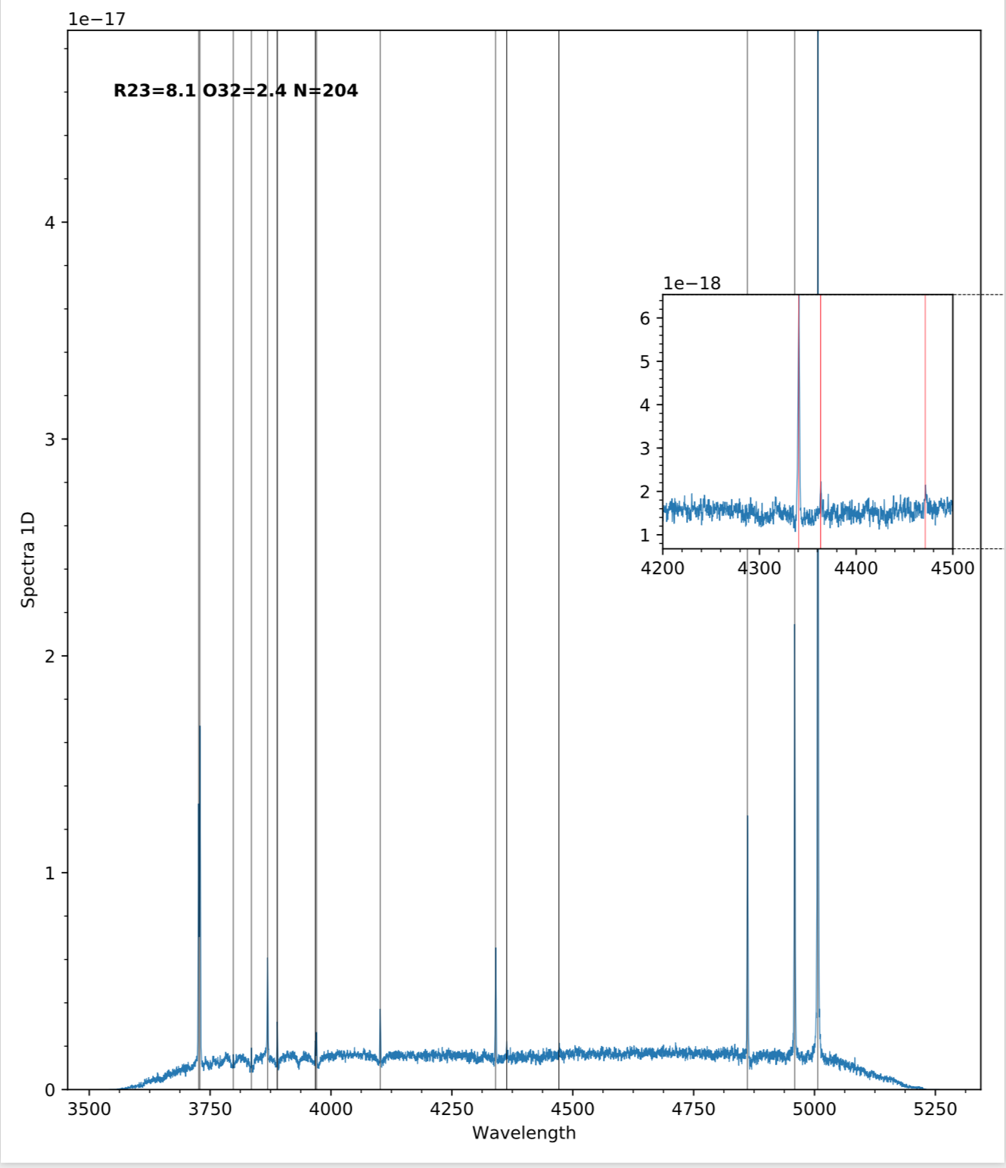
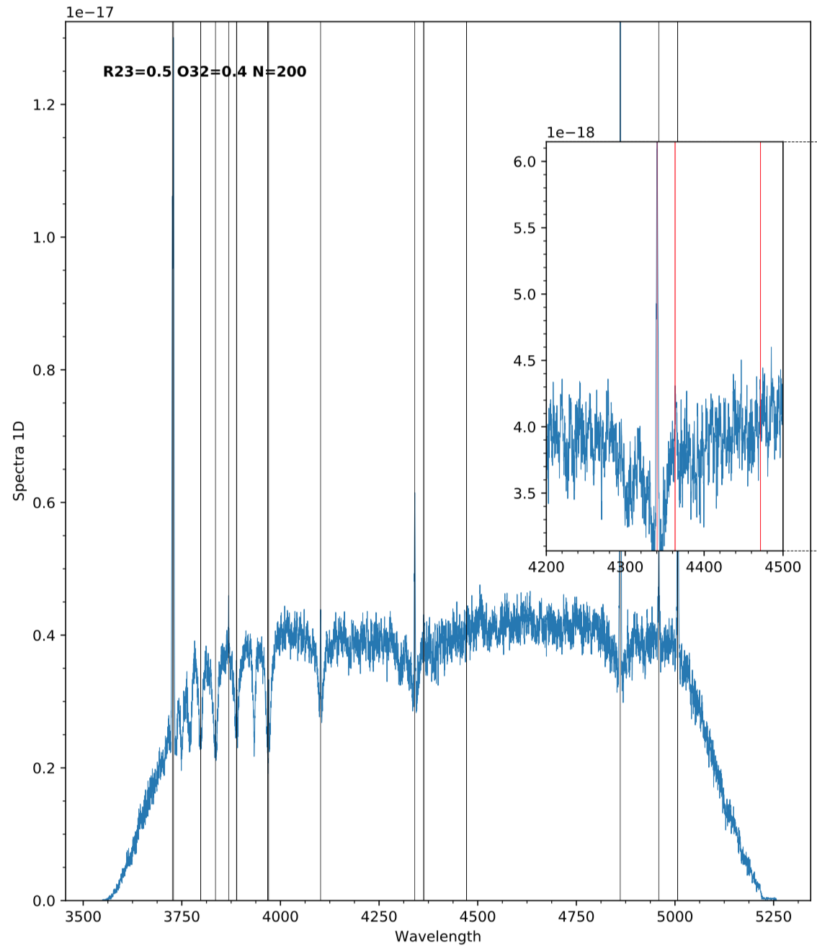
Stacked Spectra
R₂₃ = 8.1, O₃₂ = 2.4, N=204
R₂₃ = 0.5, O₃₂ = 0.4, N=200
Wavelength
Wavelength
Notes:
Once galaxies are stacked, we can see the emission line.
This is our entire spectra after it has been stacked. Both of these spectrum have detections.

Slide 12
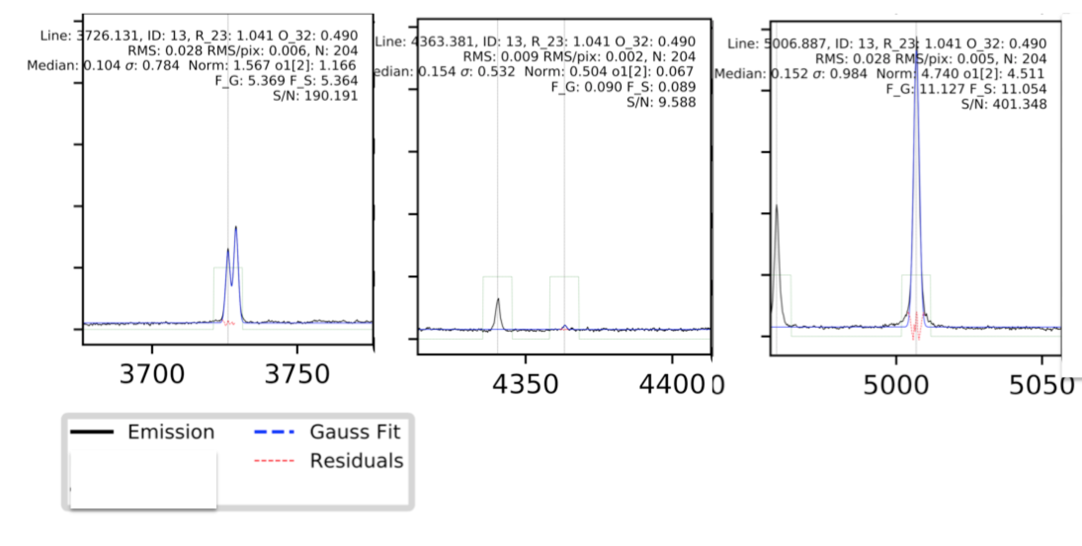
Determine the emission line fluxes with Gaussian fitting
Measure signal to noise of [O III]λ4363
λ=3727
λ=4363
λ=5007
Notes:
Next, we fit the line profiles with a Gaussian profile to determine the flux of each emission line. Pictured here are the …. for our best case

Slide 13
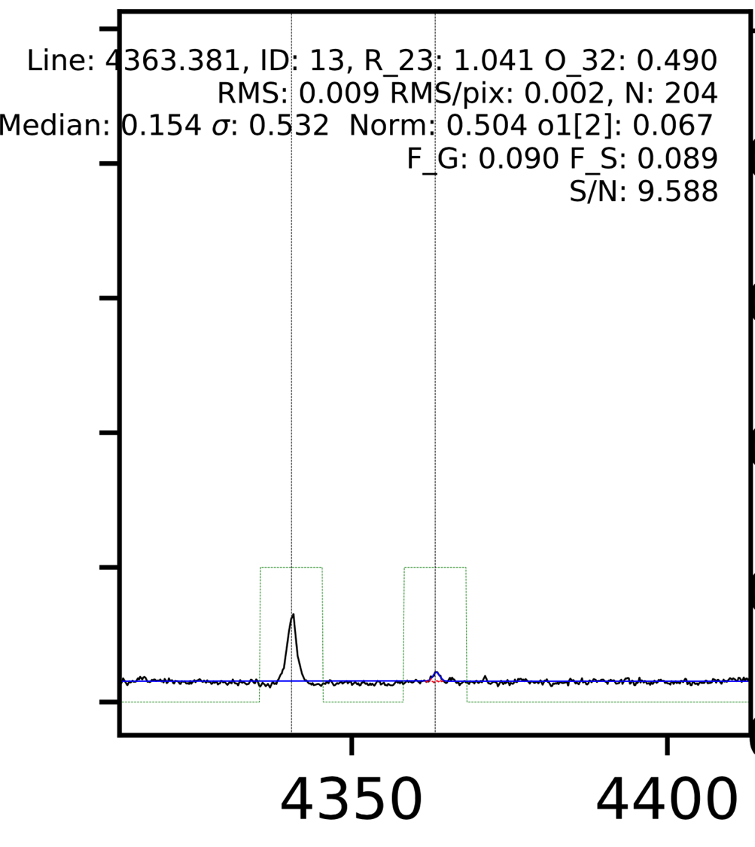
λ=4340 λ=4363
Notes:
Current best case
Point out S/N

Slide 14
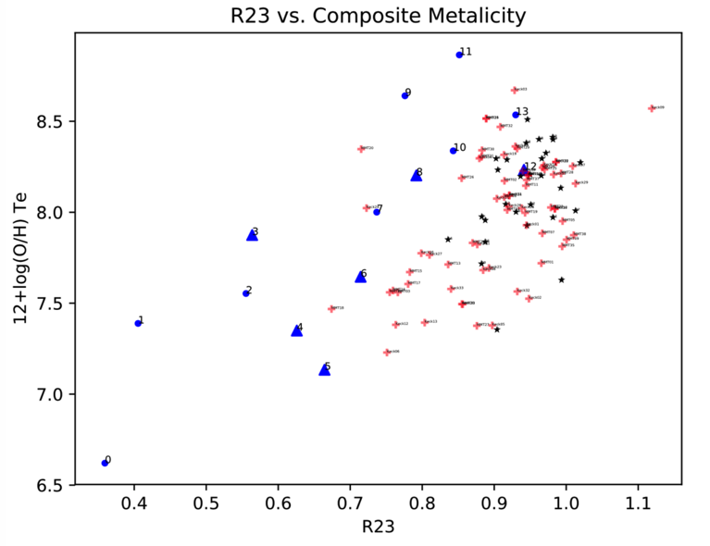
Once electron temperature is calculated, we can determine the metallicity.
Metallicity
R₂₃
Notes:
Once we have the electron temperature, we can directly calculate the metallicity of the galaxy using equations from Ly et al. 2016.
We think that the non detections are at high metallicities we have the lower limits calculated
Just R23 plot get rid of O32 and temperature slide and equations

Slide 15
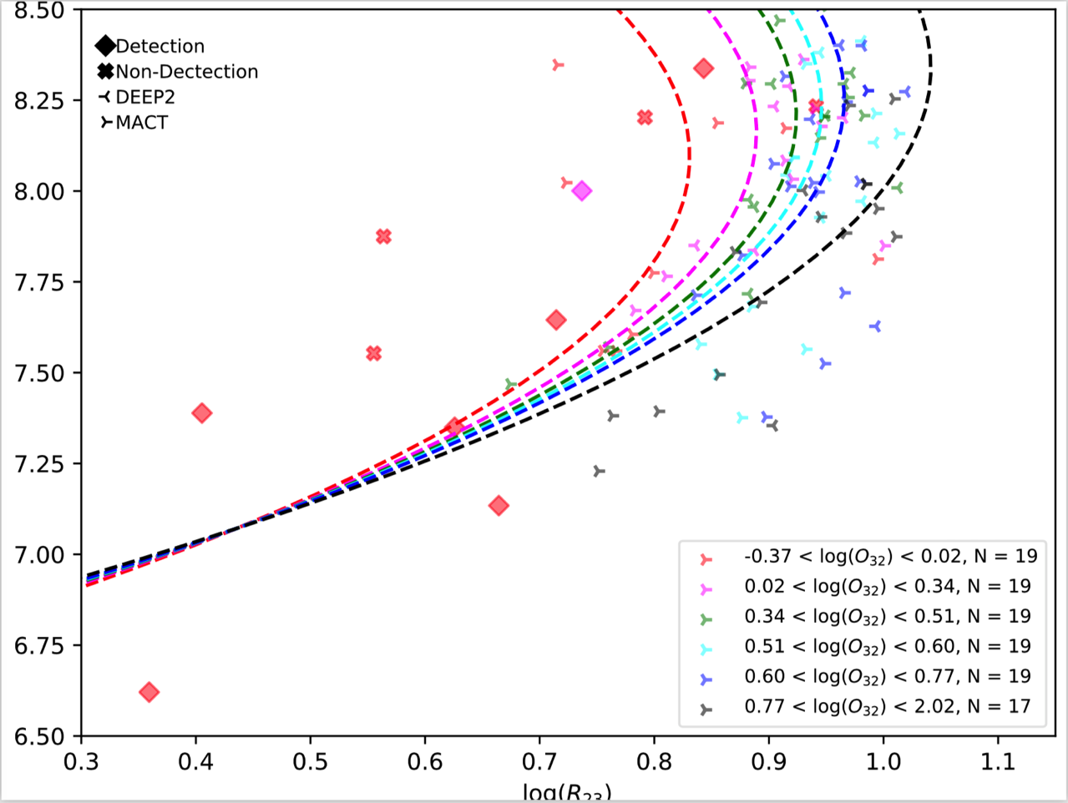
Jiang et al. (2018)
12+log(O/H)*T_{e}
Log(R₂₃)
Notes:
We can compare our data with recently published metallicity calibrations.
Used galaxies that resembled high redshift galaxies that are in the local universe.

Slide 16
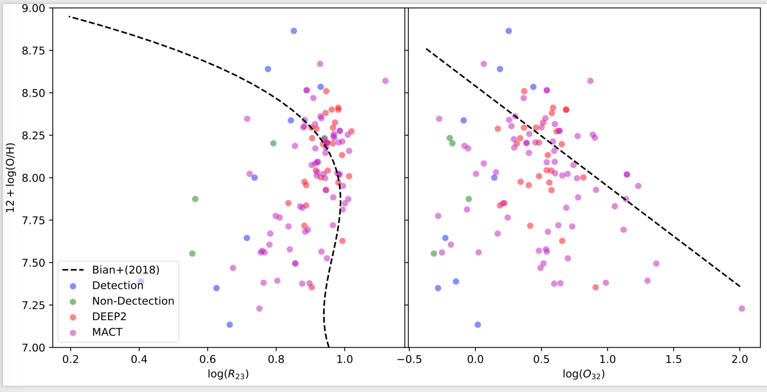
Bian et al. 2018
Log(R₂₃)
Log(O₃₂)

Slide 17
Next Steps
Investigate how the strong line ratios, R₂₃ and O₃₂, behave with metal abundances.
Linear regression and principal component analysis will be used to identify any correlation
After the DEEP2 analysis is complete, we will use the same methods to examine composite spectra from another spectroscopic survey to further develop the relationship.
Notes:
The next step is to use linear regression to investigate how R23 and O32 behave with metal abundance. Additionally, we plan to increase the sample size by adding data from the Metal Abundance across Cosmic Time survey (MACT).
“Metal Abundances across Cosmic Time” (MACT) survey will increase sample size
MACT has obtained spectra for ~1900 emission-line galaxies using the MMT and Keck in the Subaru Deep Field (SDF; Kashikawa et al. 2004; Ly et al. 2007). These galaxies were selected using a set of narrowband filters that detect redshifted nebular emission lines. The spectroscopy has detected (with signal-to-noise ratio, S/N ≥ 3) [O III]λ4363 in 66 z = 0.05–1 galaxies.

Slide 18
Acknowledgements
I would like to thank my Faculty Advisor, Dr. Chun Ly, for his support throughout this project.
I would also like to thank NASA Space Grant, specifically Michelle Coe and Susan Brew for this incredible opportunity.

Slide 19
Thank you!
Strong-line diagnostics have been used to study galaxy evolution of high redshift galaxies; however, this technique breaks down due to differences in the properties of high redshift galaxies
My Space Grant project involved recalibrating the strong-line metallicity diagnostics using reliable detections of [OIII]λ4363, a direct metallicity indicator!
By stacking thousands of spectra from the DEEP2 survey, we have detections that are used to determine average metallicities
We analyze recent calibrations and determine that the Jiang+ 2018 calibration is more reliable over the Bian+ 2018 calibration
Additional analysis are underway
Notes:
Summarize project

Slide 20
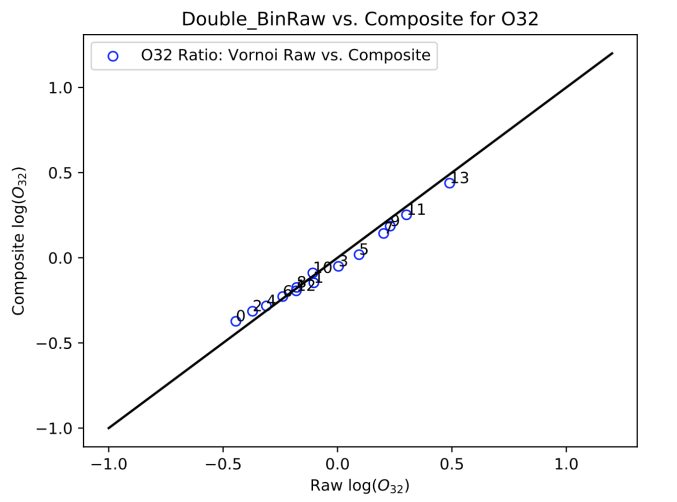
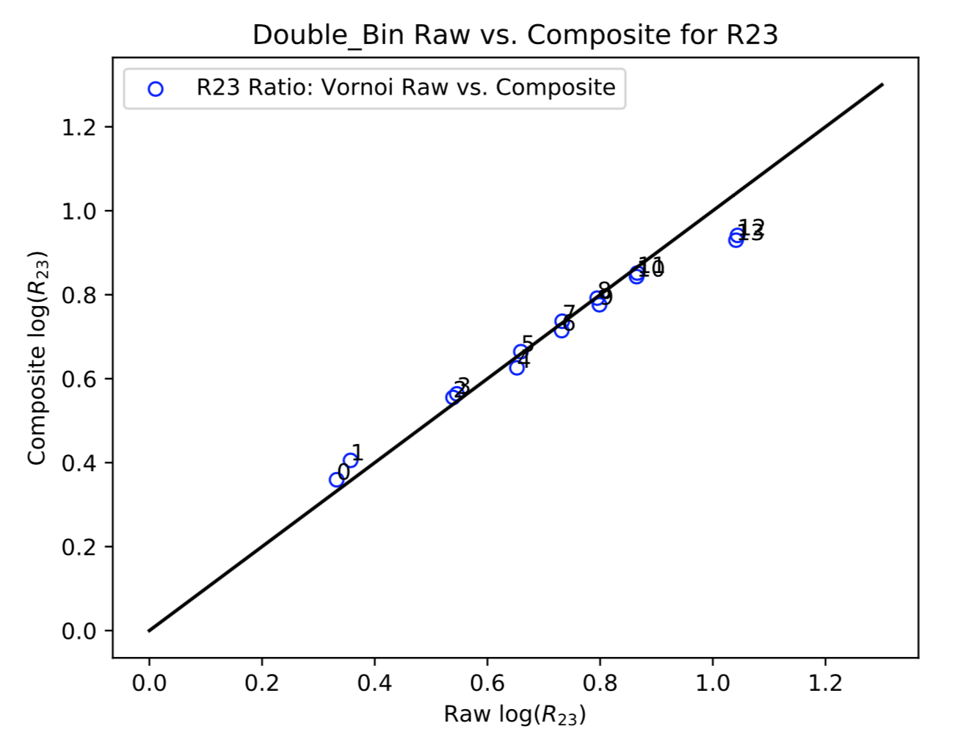
“How do you know it’s right?”
Composite Spectra Average
Voronoi Average
Composite Spectra Average
Voronoi Average
Notes:
One of the questions I was asked by a donor at the Galileo Circle Dinner was “How do you know it’s right?”
The R23 and the O32 values produced by the voronoi tellalation and the composite binning form an approximate one to one ratio which is what is expected

Slide 21
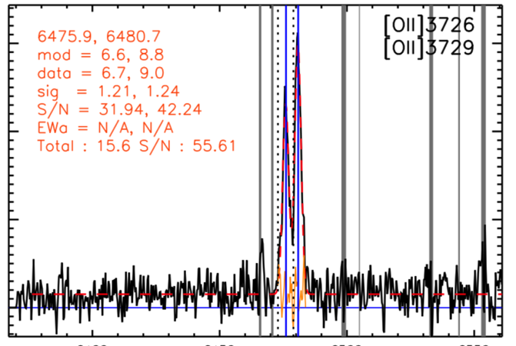
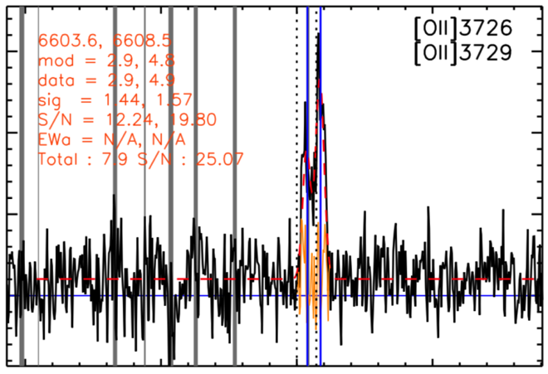
We stack the spectra in each bin, by averaging along wavelength.
Improve the S/N ratio for all emission lines
Masked out emission from the night sky to further improve the S/N ratio
Examples of individual spectrum from Keck
Notes:
Once the data is binned we can beginning stacking the spectra. By averaging along wavelength, we improve the signal to noise of each bin. We are also masking out mission lines from the night sky. Pictured here are two examples of individual spectra from the telescope. They are noisy and we would not be able to find an OIII4363 line.

Slide 22
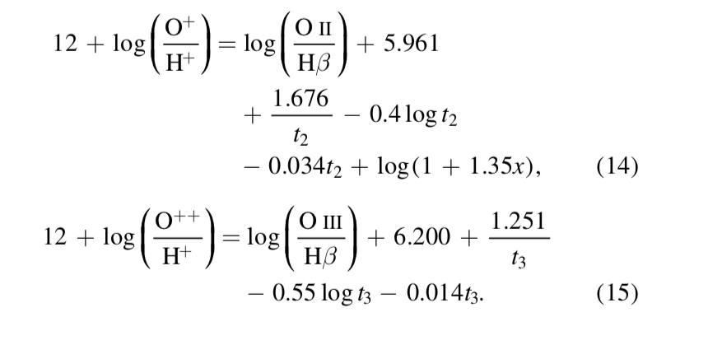
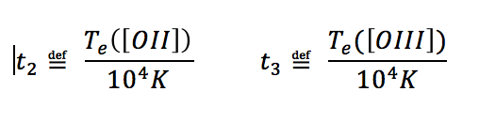
Equations for Calculating Metallicity
Equations: Ly et al. 2016

Slide 23
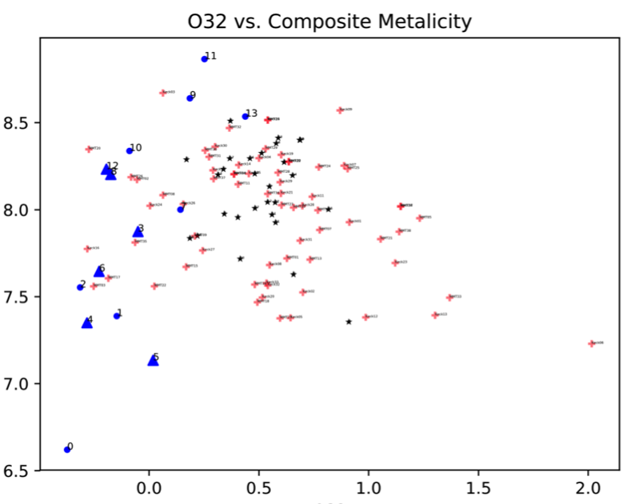
Metallicity
O₃₂

Slide 24
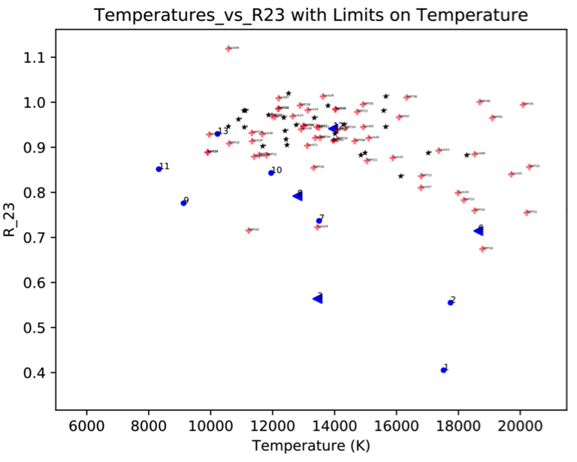
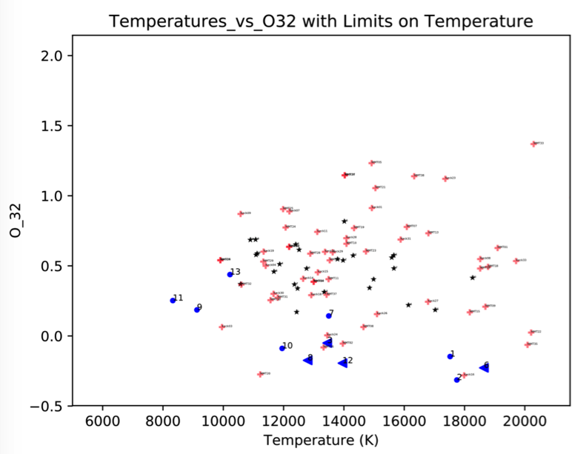
Results of electron temperatures range from ~9000 K to ~18000 K from
[O III]λ4363 detections
R₂₃
Temperature (K)
O₃₂
The typical ionized temperature is 10⁴ K for about solar metallicity
Temperature (K)
Notes:
Once we have our detections, we can calculate the electron temperature. The electron temperature is directly related to the energy of the gas particle. The average is around 12000K which is promising. The black and red points are detections from individual spectra from the DEEP2 as well as the MACT data sets.
This temperature relates to energy
Te vs R23 and Te vs O32

